Slide 1


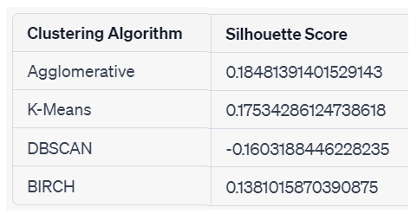
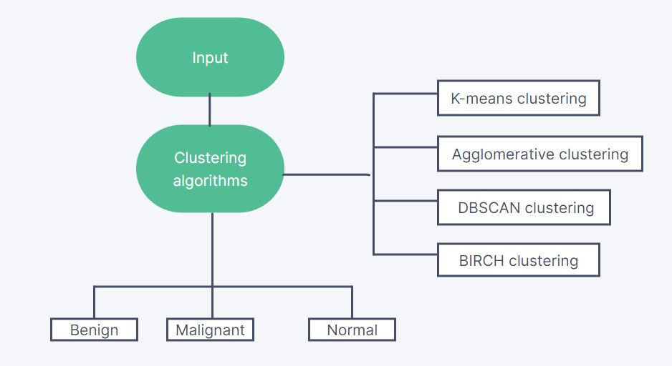
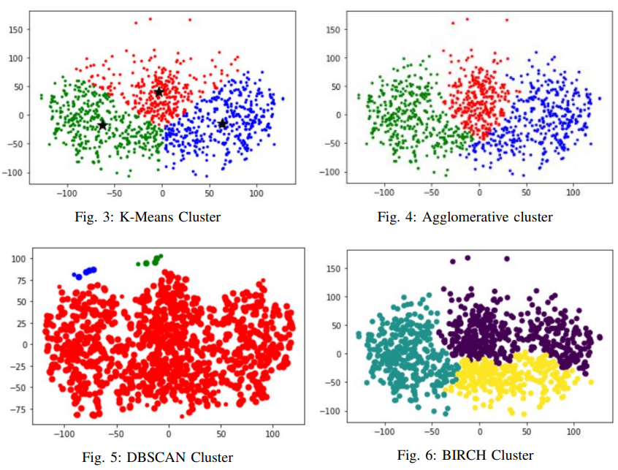
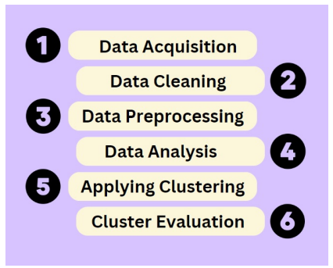
Department of AI and Machine Learning
PROJECT TITLE: Breast Cancer Prediction using Ultrasound Images
INTRODUCTION
Breast cancer is a leading cause of death among women worldwide.
Early detection is crucial for improved treatment outcomes.
Ultrasound imaging is a widely used diagnostic tool for breast cancer.
The manual analysis process of ultrasound images can be time-consuming and prone to subjective interpretation.
Machine learning has the potential to predict breast cancer based on features hidden in data.
By using machine learning to analyze ultrasound images, it may be possible to improve the accuracy and efficiency of breast cancer diagnosis, potentially leading to better treatment outcomes for patients.
METHODOLOGY
RESULTS:
K-Means:
a. Specify the number of clusters
b. Initialize cluster centroids
c. Assign data points to the nearest centroid
d. Update centroids
e. Repeat steps c and d until convergence
Agglomerative:
a. Calculate pairwise distances between data points
b. Initialize each data point as its own cluster
c. Merge the two closest clusters
d. Repeat step c until all data points belong to a single cluster
DBSCAN:
a. Choose a distance threshold and a minimum number of points
b. Initialize all data points as unvisited
c. For each unvisited point:
i. Find all neighboring points within the distance threshold
ii. If the number of neighboring points is less than the minimum, mark the point as noise
iii. Otherwise, mark the point and its neighbors as a new cluster
iv. Repeat steps i-iii for all unvisited points
BIRCH:
a. Specify the maximum number of clusters and the branching factor
b. Build a CF tree (Clustering Feature Tree) from the data points
c. Partition the tree into subclusters recursively until the maximum number of clusters is
Evaluate clustering results
OBJECTIVES & AIMS:
To develop a machine learning model to assist in the prediction of breast cancer from ultrasound images.
To develop a model that can accurately and efficiently diagnose breast cancer from ultrasound images.
Reducing the need for manual interpretation and increasing the accuracy of diagnosis.
DATASET
The "Breast Ultrasound Images Dataset" from Sciencedirect.com contains 780 ultrasound images of women aged 25 to 75 years old. It was collected in 2018 from 600 female patients and includes original and annotated images. The images are in PNG format and have an average size of 500 x 500 pixels. The dataset has three categories: normal, benign, and malignant.
CONCLUSION AND FUTURE SCOPE:
Conclusion: Agglomerative clustering performed best (score of 0.18) followed by K-Means (0.17), while BIRCH had the lowest score (0.14) and DBSCAN performed poorly with a negative score. Agglomerative clustering may be the best choice for clustering this dataset.
Future scope: Further experimentation with different datasets and algorithms is needed to confirm results. Evaluating clustering algorithms using appropriate metrics like the Silhouette score is important to improve accuracy and gain insights into data for decision-making.
GROUP MEMBERS: KAUSTUBH RAYKAR , NAJEEB SAIYED , NACHIKET ROPIA
PROJECT MENTOR NAME: DR POOJA KAMAT

